Slide 1
Regression Analysis
Multiple Linear Regression
Nicoleta Serban, Ph.D.
Professor
School of Industrial and Systems Engineering
Objectives and Examples

Slide 2

About This Lesson

Slide 3


Linear Regression: Example 1
?
?
Sales
?
Advertisement

Slide 4
Linear Regression: Data Example 1
The response variable is:
  Y = Sales (in thousands of dollars)
The predicting variables are:
  X₁ = Amount (in hundreds of dollars) spent on advertising
  X₂ = Total amount of bonuses paid
  X₃ = Market share in each territory
  X₄ = Largest competitor's sales
  X₅ = Region in which territory is located (1 = south, 2 = west, 3 = midwest)

Slide 5
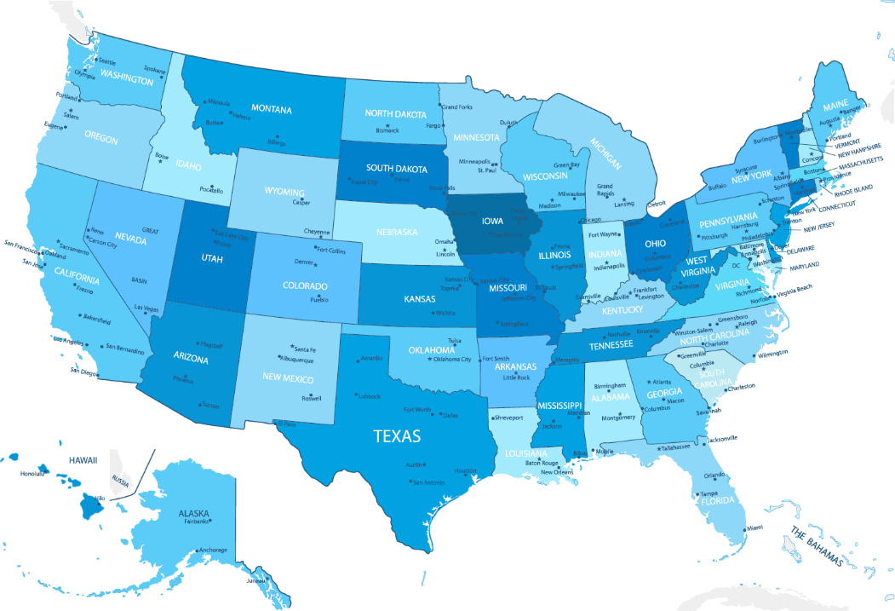
Linear Regression: Example 2
SAT Mean Score by State – Year 1982
790 (South Carolina) - 1088 (Iowa)

Slide 6
Linear Regression: Data Example 2
The response variable is:
  Y = State average SAT score (verbal and quantitative combined)
The predicting variables are:
  X₁ = % of total eligible high school seniors in the state who took the exam
  X₂ = Median income of families of test takers, in hundreds of dollars
  X₃ = Average number of years that test takers had in social sciences, natural sciences, and humanities
  X₄ = % of test takers who attended public schools
  X₅ = State expenditure on secondary schools, in hundreds of dollars per student
  X₆ = Median percentile of ranking of test takers within their secondary school classes

Slide 7

Linear Regression: Example 3
Bike sharing systems are of great interest due to their important role in traffic management.
Dataset: Historical data for years 2011-2012 for the bike sharing system in Washington D.C.
Data Source: UCI Machine Learning Repository

Slide 8
Linear Regression: Data Example 2
The response variable is:
Y = Hourly count rentals of bikes
The predicting variables are:
X₁ = Day of the week
X₂ = Month of the year
X₃ = Hour of the day (ranging 0-23)
X₄ = Year (2011, 2012)
X₅ = Holiday Indicator
X₆ = Weather condition (with four levels from good weather for level 1 to severe condition for level 4)
X₇ = Normalized temperature
X₈ = Normalized humidity
X₉ = Wind speed

Slide 9
Multiple Linear Regression: Objectives
A regression analysis is used for:
  Prediction of the response variable
  Modelling the relationship between the response variable and explanatory variables
  Testing hypotheses of association relationships
Linear Regression: The basis of what we will discussing in most of this course is the linear model. Virtually all other methods for studying dependence among variables are variations on the idea of linear regression.
All models are wrong, but some are useful. ‒ George Box
Embrace your data, not your models. ‒ John Tukey
“
”
“
”

Slide 10

Summary

